Slide 1






Copilot
Low Code/ No Code Power Platform
Virtual Conference
9th -10th November 2024
Welcome
REGISTER
DONATE
Supported by Microsoft Community

Slide 2
Copilot
Donate for the future of children
Low Code/ No Code Power Platform
Virtual Conference 2024
DONATE
Learning Together, Changing Lives
Supported by Microsoft Community

Slide 3

Copilot
Low Code/ No Code Power Platform
Virtual Conference 2024
Global Sponsor
Supported by Microsoft Community

Slide 4
Copilot
Mastering DAX Query View – Power BI Companion
Hariharan Rajendran

Slide 5







Copilot
Low Code/ No Code Power Platform
Virtual Conference 2024
Community Sponsor
Community Supporter
Supported by Microsoft Community

Slide 6

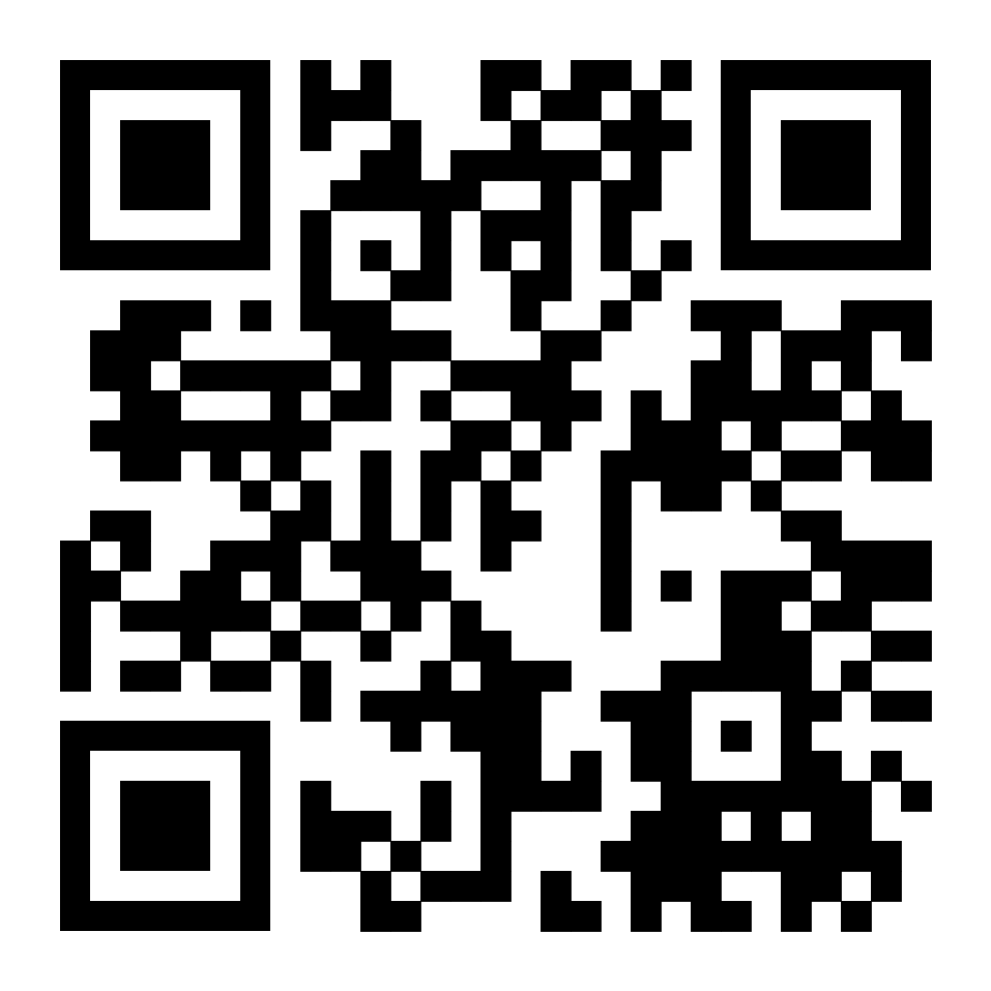
Copilot
About Hari
Microsoft MVP in Data Platform (5th time)
MCT & CompTIA Classroom Trainer
Expertise in Data & BI
Presented sessions in conferences and summits
YouTube – Hari’s BI
LinkedIn – imhariharanr

Slide 7
Copilot
Agenda
Introduction to DAX Query View
DAX Query View Use Cases

Slide 8
Copilot
Thank You
Hariharan Rajendran
LinkedIn – imhariharanr

